Slide 1
Exo-SIR: An Epidemiological Model to Analyze the Impact of Exogenous Spread of Infection

Slide 2
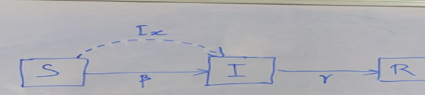
Model
Equations-
S+i+r = 1
ds__dt = -beta_x*s-beta_e*s*i
dix__dt = beta_x*s-gamma*i_x
die__dt = beta_e*s*i-gamma*i_e
dr__dt = gamma*i

Slide 3
Motive Of Optimization
The motive of this optimization is:
To find a relationship between different parameters of the exo-sir model
find the perfect strategy for lockdown, which supports economic activities and growth.
To shift the corona peak to the right side.

Slide 4
Python Libraries Used
Libraries Used for finding relationship between different parameters of the exo-sir model :
Pandas
Numpy
Scipy
Matplotlib
Sklearn
Seaborn

Slide 5
Dataset Preparation
To study the Impact of lockdown on the peak of covid-19, we have created multiple datasets with varying window sizes where the window size is the no of days during which lockdown is applied.
Window size of 2, 4, 5, 6, 8, 10, 12, 14, 20 were created and analysed
Two types of datasets were prepared first one where cases were increasing and second where cases were decreasing inside these windows.

Slide 6
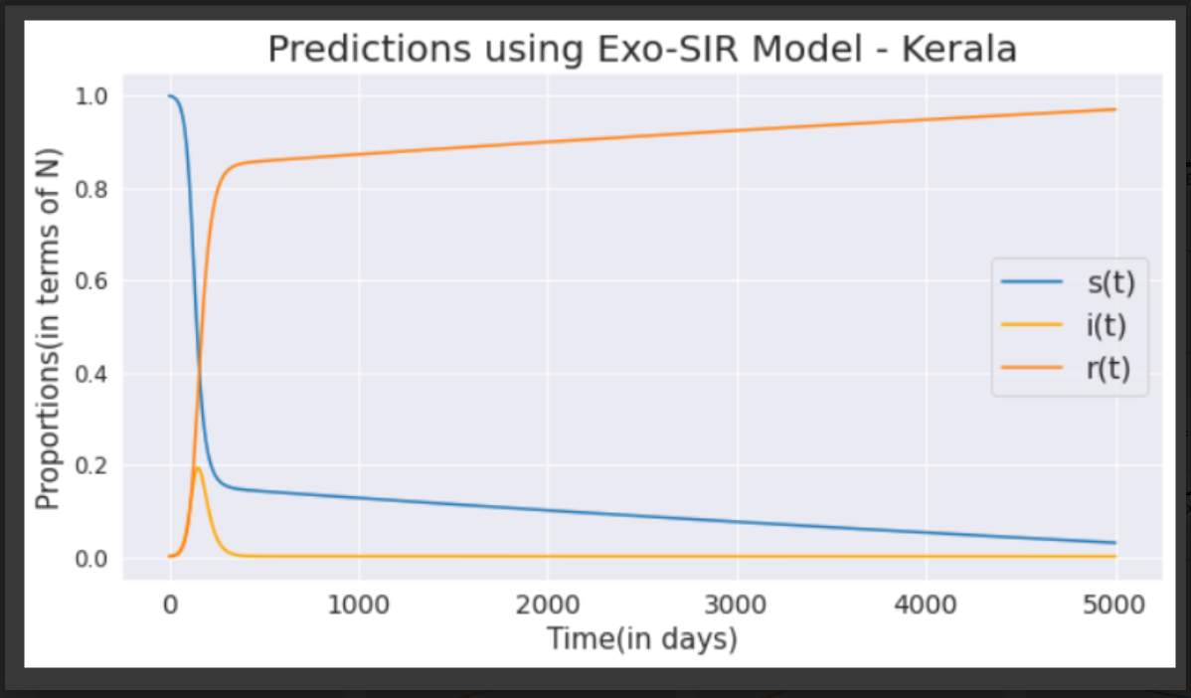
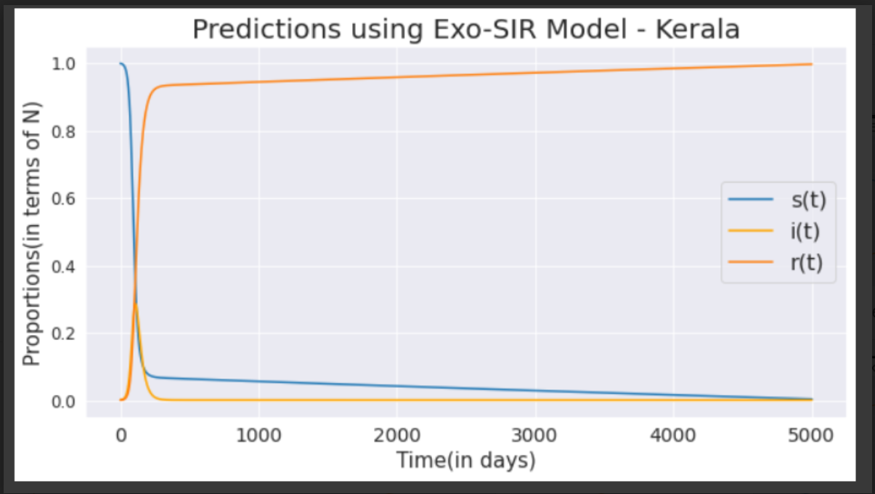
Cyclic Results
windows=2
window=4

Slide 7
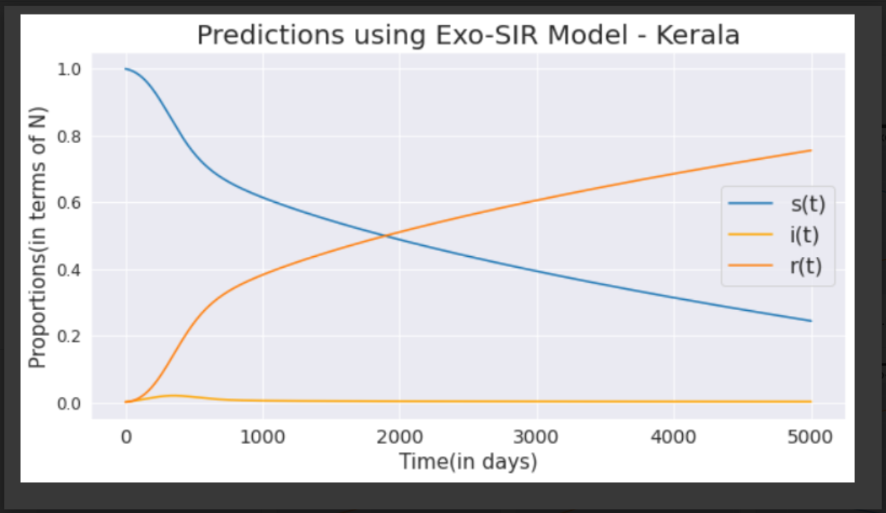
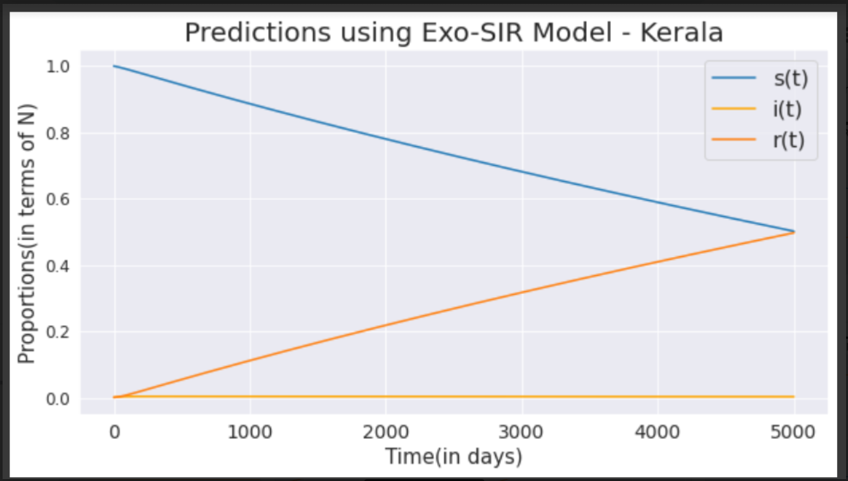
Cyclic Results
window=5
window=6

Slide 8
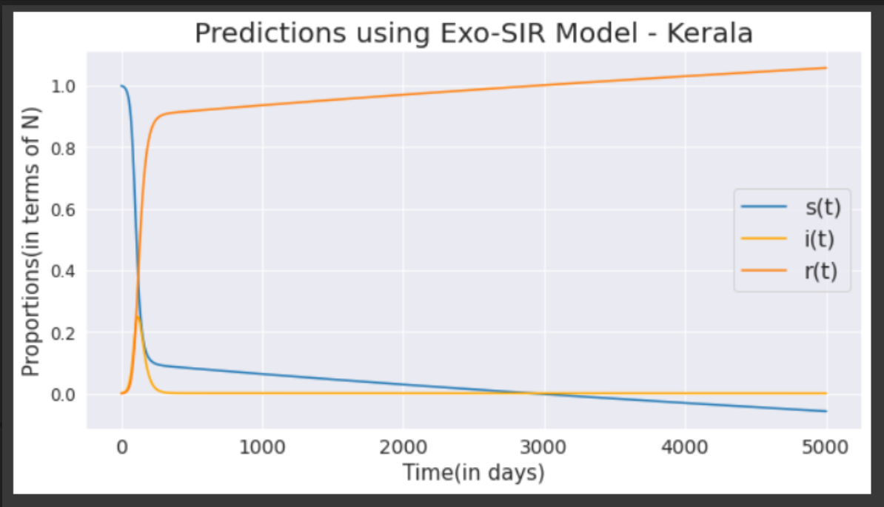
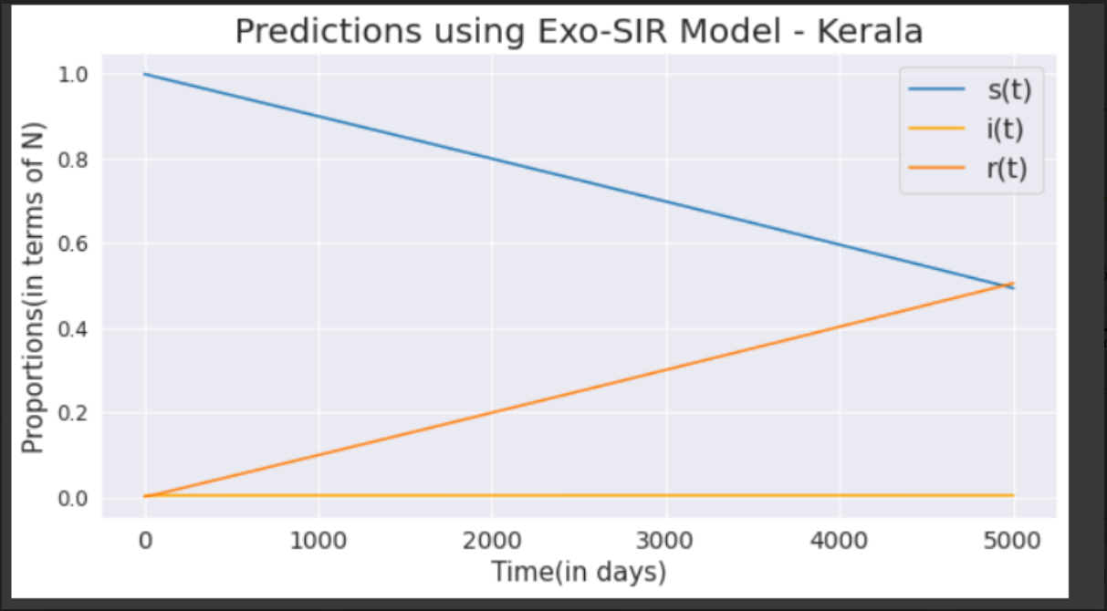
Cyclic Results
Window=10
window=20

Slide 9
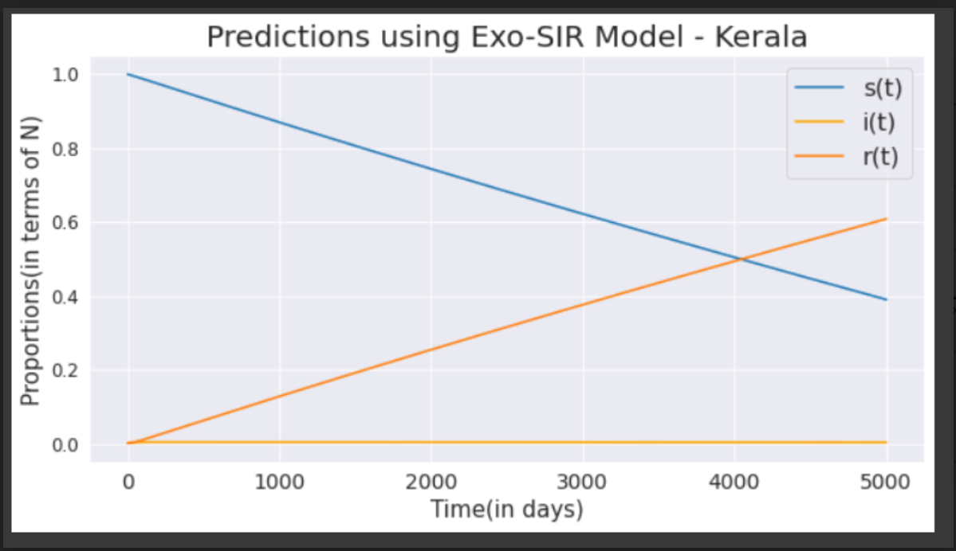
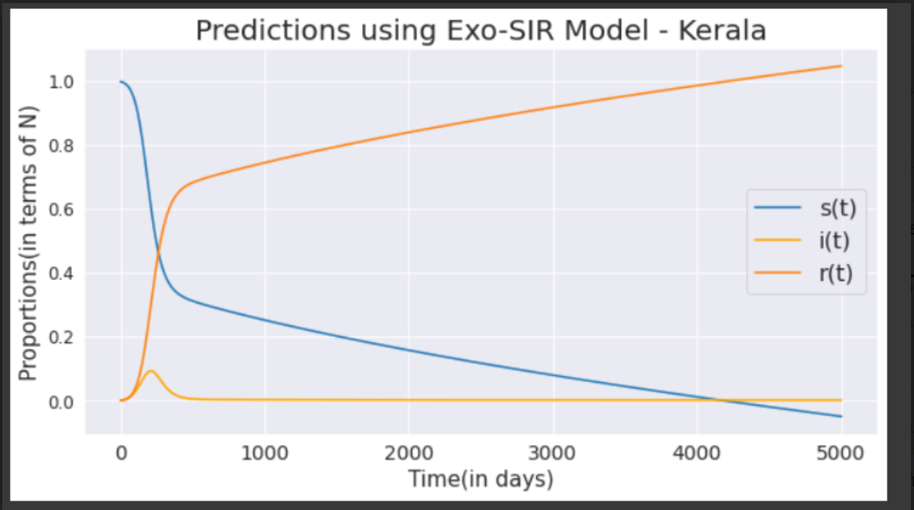
Window=12
window=14

Slide 10
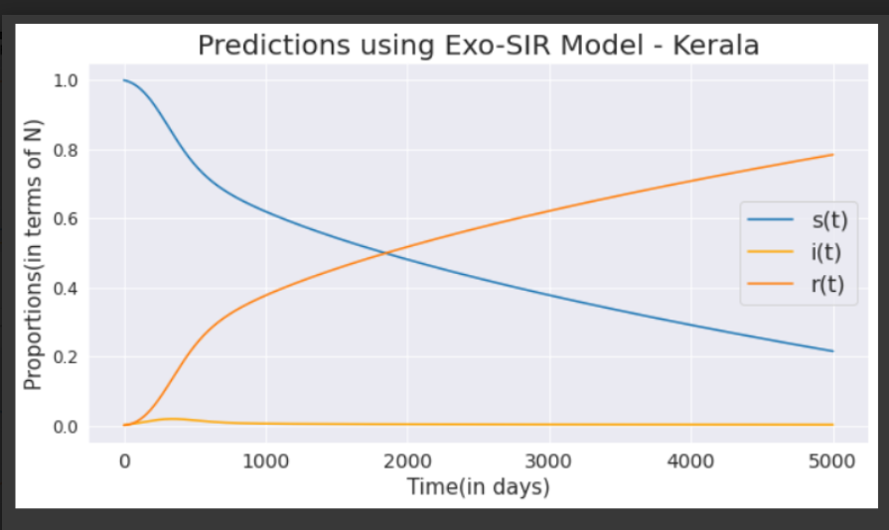
Conclusion that 8 window size was giving best output
We found that window size of 8(lockdown for 8 days ) was giving better peak as compared to other window size.
window=8

Slide 11
Real world Analysis
Real World analysis were then done on indian state kerela for different cases and values for S,i,t were obtained.

Slide 12
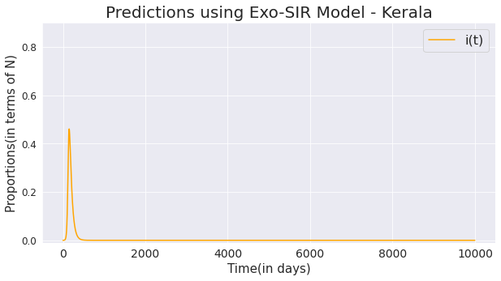
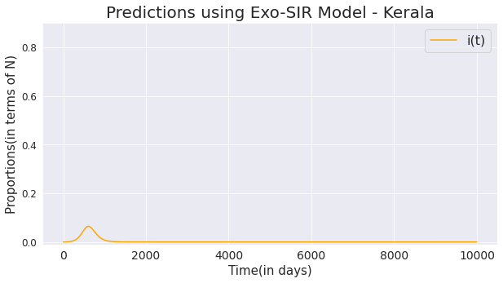
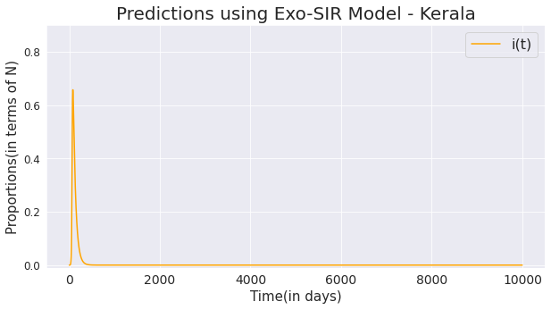

Slide 13
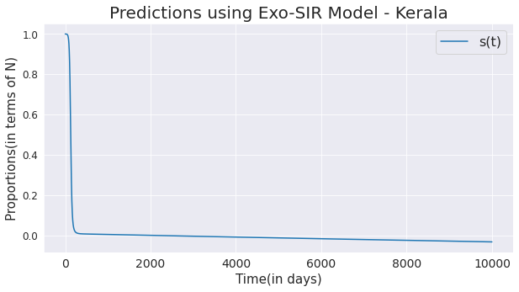
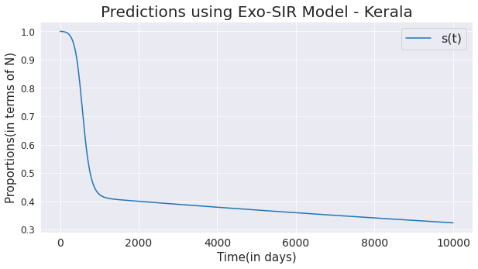
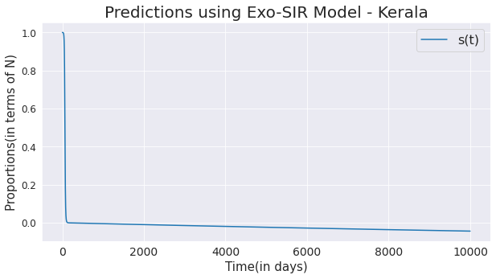

Slide 14
